Slide 1
WORLD POPULATION
Group 6
Vu Thi Que Anh - 20070900
Nguyen Thu Huyen - 20070937
Nguyen Thi Yen Nhi - 20070968
01

Slide 2
TABLE OF CONTENTS
01
02
03
04
05
06
DISCOVERY
DATA PREPARATION
MODEL PLANNING
MODEL BUILDING
RESULTS COMMUNICATION
CONCLUSION AND RECOMMENDATION
02

Slide 3
01
DISCOVERY
03

Slide 4
WHAT ARE POTENTIAL BENEFITS?
The world's population faces many challenges and problems. By predicting future population growth, governments, organizations, and policymakers can better plan and allocate resources in areas such as healthcare, education, infrastructure, and food production. It allows for more effective long-term planning and helps ensure that adequate resources are available to meet the needs of the growing population.
04

Slide 5


DESCRIPTIVE METHOD
TABLEAU
PYTHON
Visualize the data in order to acquire a general understanding of it. To better understand the global population, interactive graphs and charts in the form of dashboards and sheets are helpful.
Analyze the performance of models like Linear Regression, Decision Tree, and Random Forest to determine which model is more accurate at forecasting future global population changes.
05

Slide 6
DATA PREPARATION
06

Slide 7
DATASET: World Population
Number of Instances: 234
Number of Attributes: 17
Attribute information:
Rank: Rank by Population
CA3: 3 Digit country/Territories Code
Country/Territories: Name of the Country/Territories
Capital: Name of the Capital
Continent: Name of the Continent
The population: Population of the Country/Territories in the year 2022/2020/2015/2010/2000/1990/1980/1970.
Area (km²): Area size of the Country/Territories in square kilometers.
Density (per km²): Population Density per square kilometer.
Growth Rate: Population Growth Rate by Country/Territories.
World Population Percentage: The population percentage by each Country/Territories.
07

Slide 8

MODEL
PLANNING
Data preprocessing is a technique for gathering unprocessed data and turning it into information that is relevant and valuable.
08

Slide 9
PYTHON
TABLEAU
The duplicate or missing data was then sorted, screened for, and processed, and the data was then transformed into a format suited for analysis and straightforward result prediction.
Using SQL to process data: By creating a new data file, use union all to combine data from the population tables of each year into one column.
09

Slide 10

MODEL
BUILDING
10

Slide 11
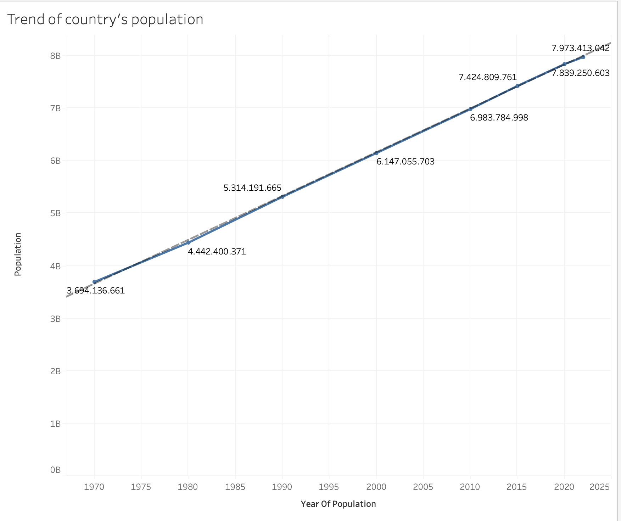
TABLEAU
Currently, the world's population is three times greater than it was in the mid-20th century. In 2020, for the first time since 1950, the population growth rate will fall below 1% per year and is forecast to continue to slow down over the next few decades. This is forecast to continue until the end of the century, the global population could grow to 8.3 billion by 2025.
It may be claimed that the global population is on the decline and will likely continue to do so for many years to come. Each nation and territory's economy, culture, society, ecology, etc. may be impacted by the population decline trend.
World population trends: 1970 to 2025
11

Slide 12
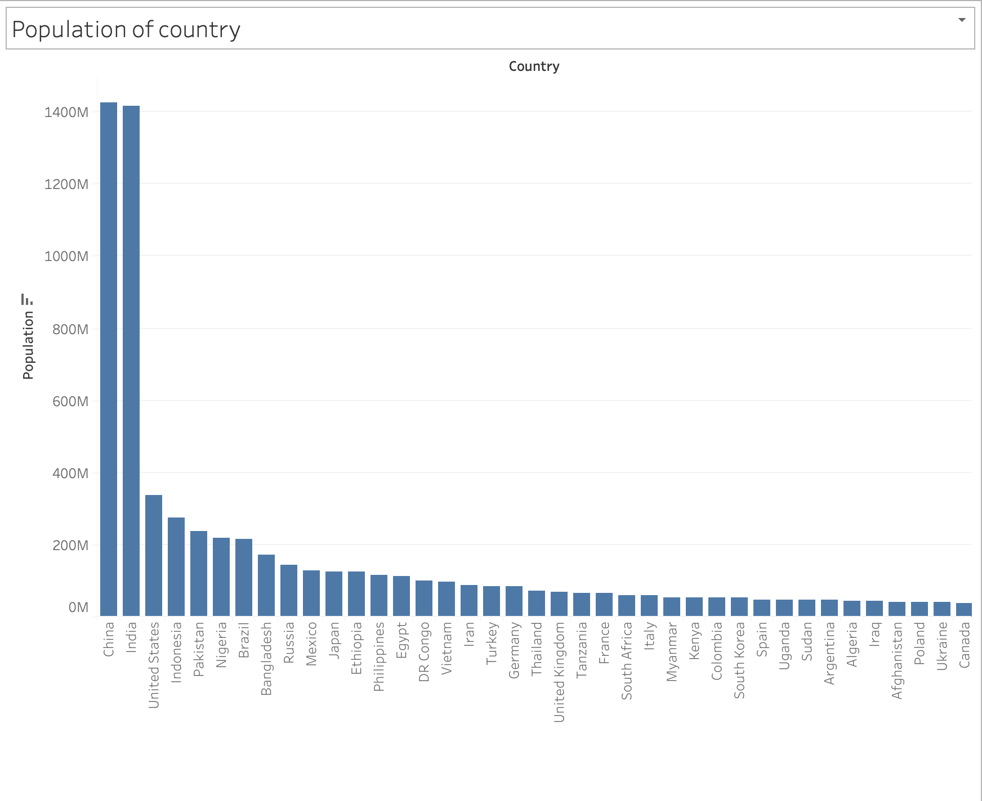
TABLEAU
Top 10 most populous countries in 2022
China is the most populous country in the world with 1.4 billion people followed by India, United States and others.
Why?
Long histories, strong family traditions, early births, and high birth rates are all aspects of culture and history.
Population growth is significant derived by education as well
Periods of political stability, economic expansion, and technical innovation in these nations have all fueled population rise.
12

Slide 13
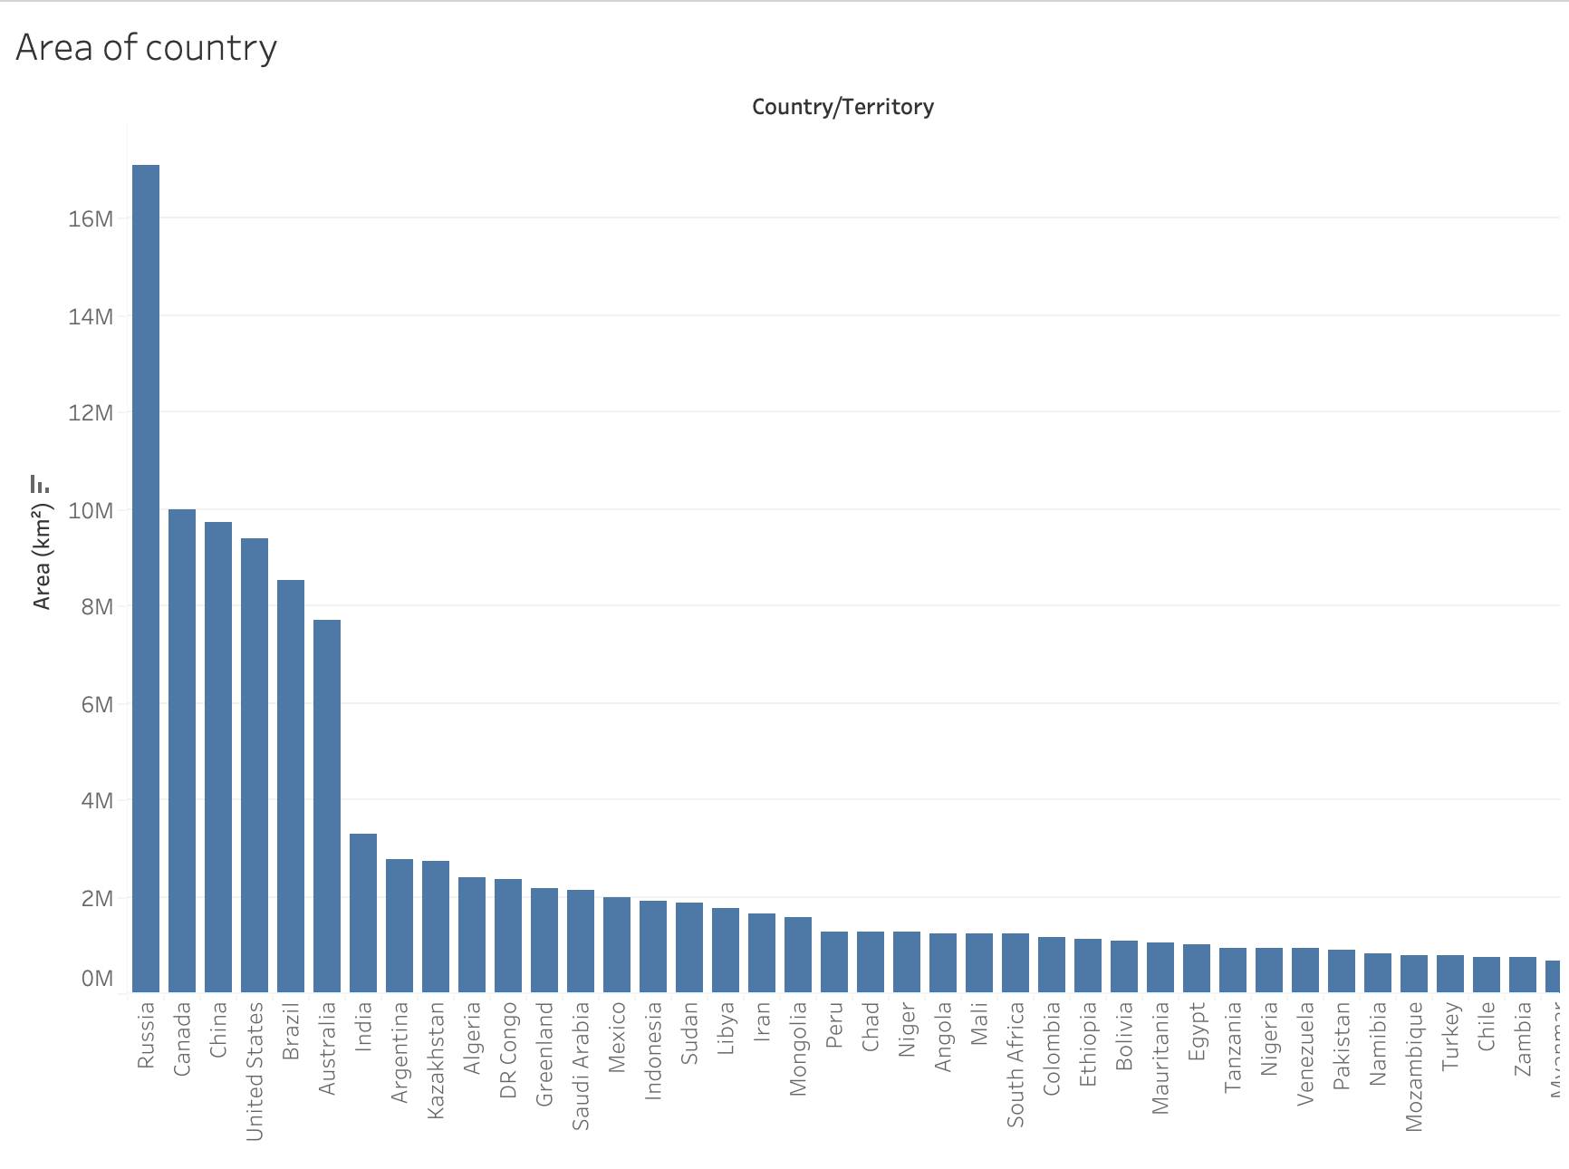
TABLEAU
Top 10 countries with the largest area
Russia is the country with the largest area, followed by Canada, China and others.
With such a large area, why don't people choose Russia or Canada to live?
Russia has a cold climate and the cold lasts for a large part of its territory. Meanwhile, Canada has a cold and harsh climate in many areas, especially the North. This extreme climate may reduce the attractiveness of the two countries to some.
13

Slide 14
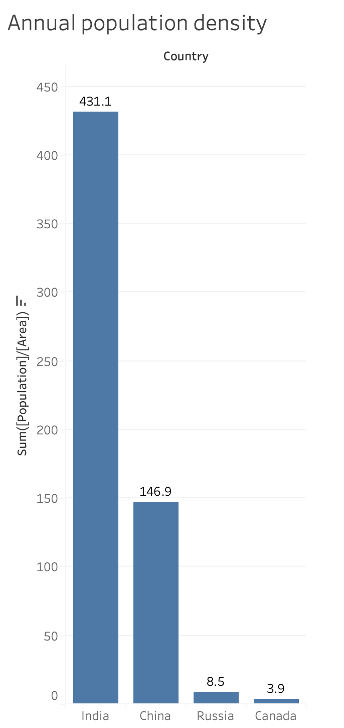
TABLEAU
The vast areas of Russia and Canada are unevenly dispersed.
Russia and Canada have much lower population densities than China and India in 2022. In a square kilometer, more than 400 Indians live, while in Russia only about 9 people live and in Canada only 4 people live.
→ People will prioritize places with dense population to develop the economy, education and people.
14

Slide 15
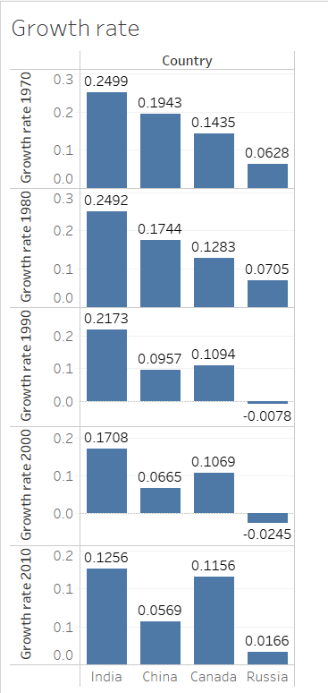
TABLEAU
Population growth rate from 1970 to 2010
As we can see, India has had the highest population growth worldwide throughout the years, but its growth rate is rapidly slowing down. Next, China currently has the highest population, but it is growing at a slower rate than India, and during the past ten years, that rate has been dramatically declining.
In contrast to the previous two nations, Russia and Canada have growth rates that are rather variable. Russia's growth rate fell between 1970 and 2000, but it rose (0.0166) from 2010 to 2011.
15

Slide 16
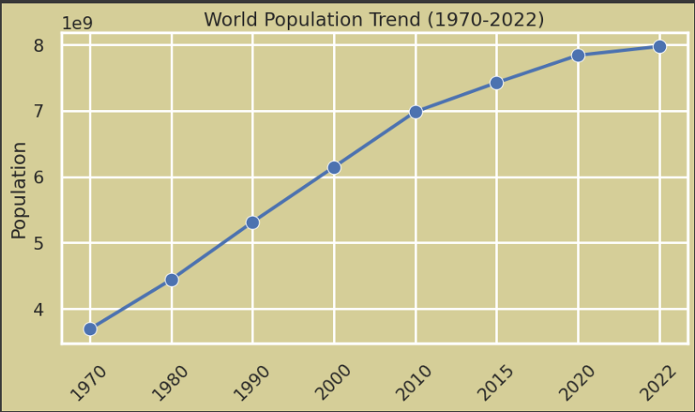

PYTHON
Data analysis and Visualization
About the overall population change, we see that the world population from 1970 to 2022 in general has an increasing trend. However, whereas the global population increased quickly between 1970 and 2015, it is expected to grow more slowly between 2020 and 2022.
16

Slide 17
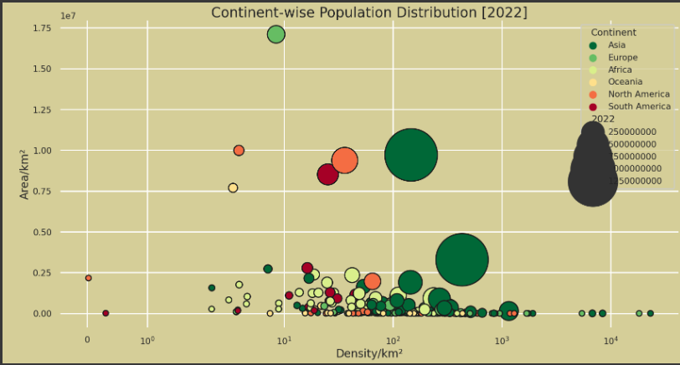
PYTHON
Data analysis and Visualization
Regarding the distribution of the world's population by continent, the graph shows that nearly all Asian nations have large populations and high population density.
Abundant natural resources
A large and diverse consumer market.
→ Creates favorable conditions for economic development, investment and business expansion.
17

Slide 18
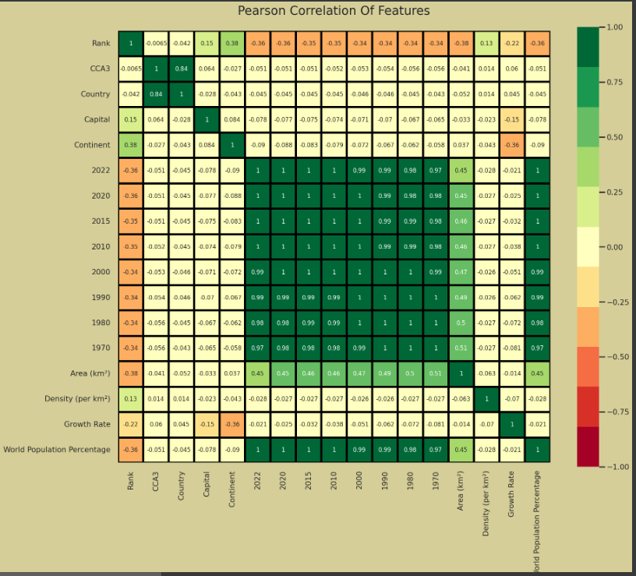
PYTHON
Data analysis and Visualization
Here is a graph showing the correlation between the variables:
High correlation between population and world population percentage. Also, high correlation between country and CCA3 code as expected. Medium correlation between area and population, area and world population percentage.
18

Slide 19
PYTHON
b. Prediction
As a result of statistical correlation between variables, we find that the population in 2022 has highly correlated with World Population Percentage, Growth Rate, Density, Area, and the population of the years 1970, 1980, 1990, 2000, 2010, 2015, 2020.
⇒ We selected those variables as the input for the data model. The population in 2022 is the main output. We choose random_state to be equal to 1 and divide the train and test datasets by an 80:20 ratio.
19

Slide 20
PYTHON
b. Prediction
We would be able to compare related evaluation metrics like R2 score, MAPE score, and RMSPE score.
R-square measures the explanatory power of the model for the dependent variable.
Mean Absolute Percentage Error (MAPE), Root Mean Square Percentage Error (RMSPE) measures the mean error of the model when applied to predict the value of the dependent variable on a test set.
20

Slide 21
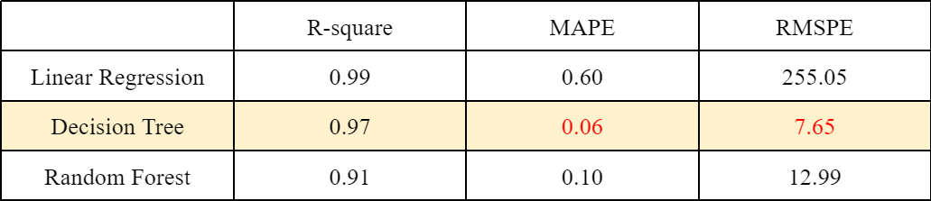
PYTHON
b. Prediction
Following each model being run, the R-square, MAPE, and RMSPE score are shown here:
⇒ The Decision Tree model outperforms the other two models as a predictor model.
21

Slide 22
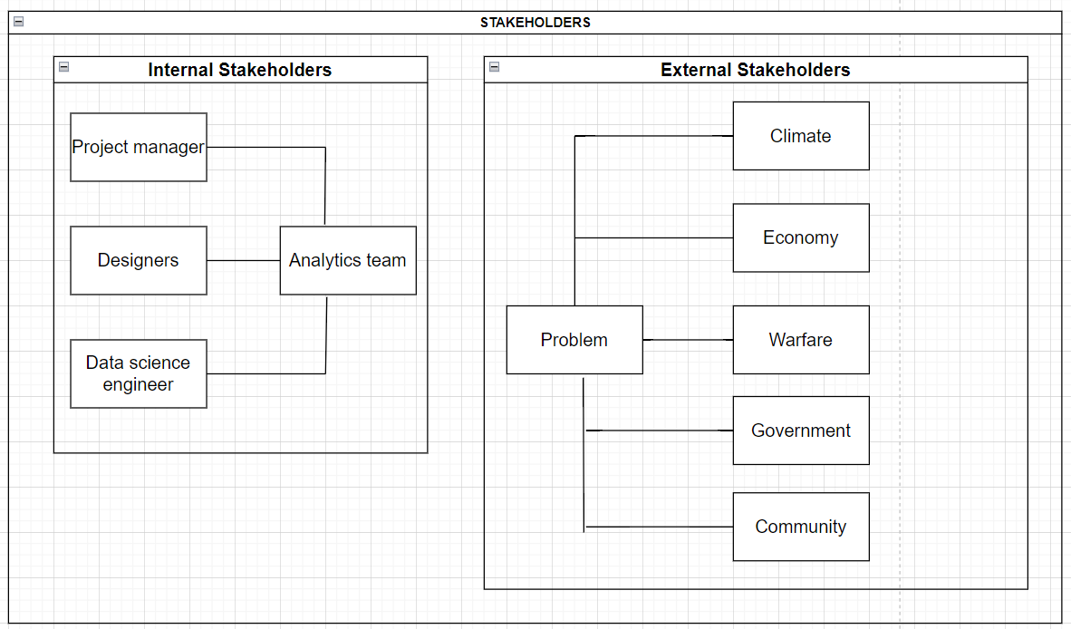
RESULTS COMMUNICATION
Identify stakeholders
22

Slide 23
RESULTS COMMUNICATION
2. Key findings
Over the years, there has been a steady rise in global population. It is predicted that there will be 7.9 billion people on earth by 2022. Although it has been gradually slowing down, population growth is still increasing.
Population Growth
The distribution of the world population is uneven, with some regions experiencing rapid population growth while others have slower growth or even declining populations. The most populous countries include China, India, the United States, Indonesia, and Pakistan.
Population Distribution
The increasing world population places pressure on natural resources and the environment. Issues such as food security, water scarcity, deforestation, and climate change are closely linked to population growth and consumption patterns.
Impact on Resources and Environment
23

Slide 24
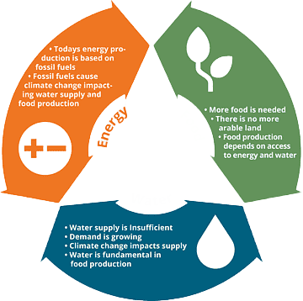


RESULTS COMMUNICATION
3. Business Value
Food
Drink
Able to preserve sustainability, spot development prospects, and create strategies that reflect current market trends as a result.
Better planning and allocating resources like food, water, energy, and infrastructure.
Can better understand consumer behavior and preferences by using population predictions.
24

Slide 25

RESULTS COMMUNICATION
4. Narrative to summarize and convey findings to stakeholders
The population of the planet is still increasing, although at a slower rate. China currently has the most people per country in the world, with India coming in second. By 2023, India is expected to surpass China as the world's most populated nation. The economies of countries with large populations won't be able to keep up with the population growth if it keeps increasing at the current rate.
⇒ If populations are not managed within reasonable boundaries, all efforts to bring about peace, comfort, and welfare for all will be frustrated, and suffering will become more evident.
25

Slide 26
CONCLUSION AND
RECOMMENDATION
The prediction of world population is crucial in a variety of sectors, including government, business, and social development. It provides valuable insights into resource planning, economic forecasting, healthcare management, environmental impact assessment, and policy formulation.
Recommendation:
Stay informed about population projections and demographic trends to anticipate market shifts and consumer behavior changes.
Anticipate future market demands, infrastructure needs, and resource requirements to ensure sustainable growth and competitiveness.
Decision Tree models should be used by businesses, especially small and medium-sized ones, to forecast population.
26

Slide 27
THANK YOU FOR LISTENING
27

